Slide 1
Introduction to University Life COURSE INTRODUCTION
Assoc. Prof. Dr. Havva Sert

Slide 2
Introduction to University Life
The aim is to provide students with information covering social, personal, and academic life skills that will facilitate their adaptation to university life.
Within the scope of the course, students are introduced to the academic and administrative units of Sakarya University, the facilities offered, regulations/guidelines, cultural and scientific events conducted within the university environment, and general information about the city of Sakarya.

Slide 3
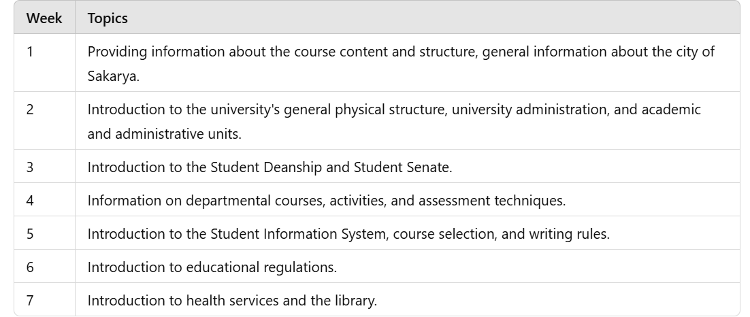
Introduction to University Life Course Topics

Slide 4
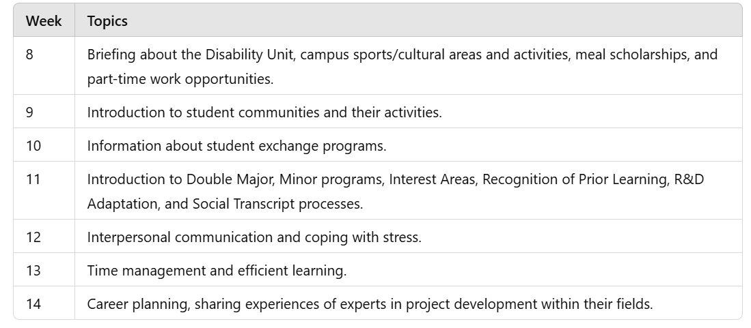
Introduction to University Life Course Topics

Slide 5
Introduction to University Life Course Evaluation
1 Mid-Year Evaluation Exam
1 End-of-Year Evaluation Exam
YT/YZ

